Slide 1
Labor Market Update q1 2026
Alexandria/Arlington
Marisa Hayes
Senior Research Analyst, Labor Market Intelligence

Slide 2
Employment
 | Total Employment
 | Dec. 2024 | Dec. 2025
Northern Virginia | 1.64 M | 1.62 M
D.C. MSA | 3.41 M | 3.35 M
United States | 158.32 M | 158.50 M
% Change in Total Employment, Year-Over-Year
Source: U.S. BLS, Current Employment Statistics, March 3, 2026, https://www.bls.gov/ces; State and Area Employment, March 3, 2026, https://www.bls.gov/sae/.
NOTE: Total nonfarm employment, seasonally adjusted. Northern Virginia data is for the Arlington-Alexandria-Reston, VA-WV Metropolitan Division.

Slide 3
Employment by Industry
% Change in Employment, Dec. 2024 to Dec. 2025
NOTE: Data is not seasonally adjusted. Data only includes industries comprising at least 1% of total nonfarm employment (about 16,000 employed). Data is for the Arlington-Alexandria-Reston, VA-WV Metropolitan Division.
Source: U.S. BLS, State and Area Employment, March 3, 2026, https://www.bls.gov/sae/.

Slide 4
Job Postings
Total Postings by Month, NOVA Service Area
Source: Lightcast Analyst (2026.1 release).

Slide 5
Job Postings by Industry
% Change in Job Postings, Feb. 2024 to Feb. 2026
NOTE: Only includes industries with at least 500 job postings in Feb. 2026.
Source: Lightcast Analyst (2026.1 release).

Slide 6
Unemployment
 | Total Unemployed
 | Dec. 2024 | Jun. 2025 | Dec. 2025
Alexandria/Arlington | 5,273 | 8,970 | 7,958
NOVA Region | 32,734 | 53,780 | 47,668
D.C. MSA | 96,034 | 141,747 | 133,530
Trend in Unemployment Rates
NOTE: Data is not seasonally adjusted. Data was unavailable in October 2025.
Source: U.S. BLS, Local Area Unemployment Statistics, March 3, 2026, https://www.bls.gov/lau.

Slide 7
Labor Force
 | Total Labor Force
 | Dec. 2024 | Dec. 2025
Alexandria/Arlington | 256.1 K | 251.8 K
D.C. MSA | 3.55 M | 3.49 M
United States | 167.75 M | 170.72 M
% Change in Labor Force, Year-Over-Year
NOTE: Data is not seasonally adjusted. Data was unavailable in October 2025.
Source: U.S. BLS, Local Area Unemployment Statistics, March 3, 2026, https://www.bls.gov/lau; Current Population Survey, March 3, 2026.

Slide 8
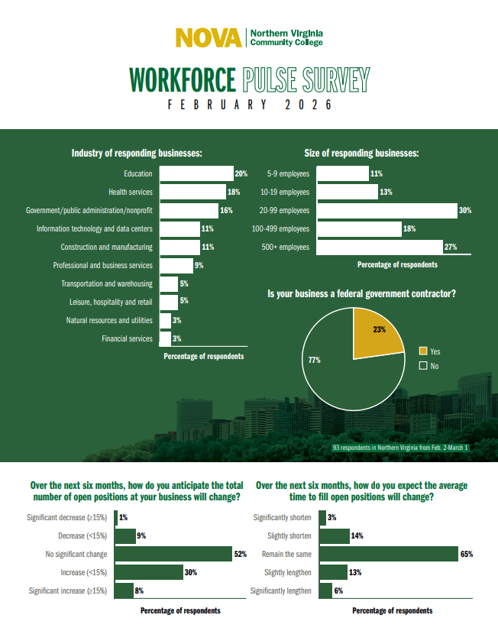
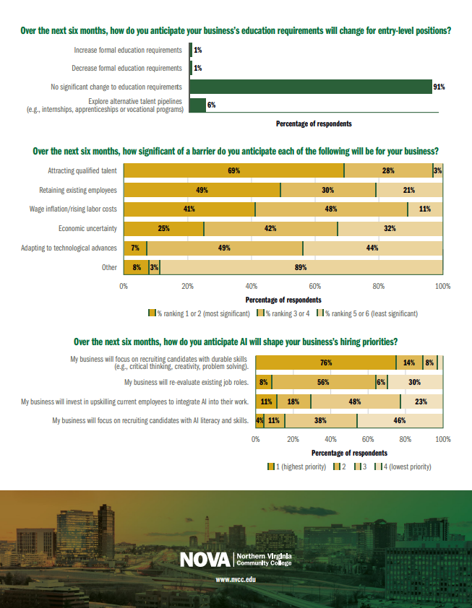
Expected Future Changes
Insights from the February 2026 Workforce Pulse Survey
Little to no change in total number of open positions over the next six months
  Some businesses may see moderate increases
No significant changes to education requirements
Attracting and retaining talent are expected to be the most significant barriers for businesses
  Wage inflation and rising labor costs may also pose challenges
In response to AI, businesses will focus on recruiting candidates with durable skills (e.g., critical thinking and problem solving)
View the results of the newest Workforce Pulse Survey.

Slide 9
Questions?
Marisa Hayes
Senior Research Analyst,
Labor Market Intelligence
mhayes@nvcc.edu

